Slide 1
Healing at the Orisha Gardens & Gardens of the Gods
EXCEPTIONAL HEALING FOR THE PHYSICAL BODY AND MIND

Slide 2
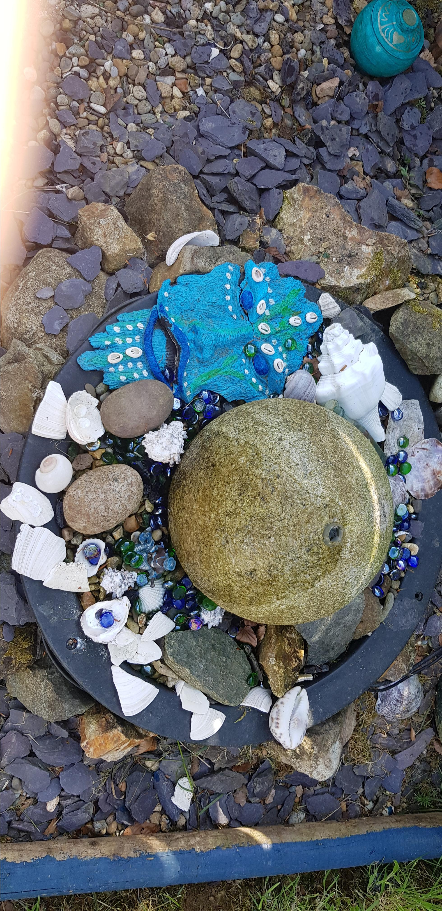
Welcome to the Place of the Gods

Slide 3
DISCONNECTION
It's TRUE, we have become disconnected from the powers and mysteries abound in nature.
We have forgotten the healing abilities of the higher dimensions
In doing so, we have placed our faith in pharmaceuticals.
Each pill popped from its metal jacket seeks only to keep us alive. It isn’t a cure, merely a stabiliser.
True health comes when we ask for assistance from the hidden powers of these sacred gardens, here we enter into a symbiotic relationship.
The Orishas + Prayer + Understanding + Natures Pharmacy = WHOLENESS

Slide 4
NATURE TRANSFORMS

Slide 5
THE ORISHA’S LISTEN
When we call for help spirit listens !

Slide 6
DISEASE IS...
All dis-ease which manifests in the physical body to us in the western culture comes in via a seemingly unknown source. Though often is has already revealed itself as something out of balance within our emotional body. It may be experienced as depression or an impassioned expression of anger, frustration, or fatigue.
It is in the emotional body where physical illness takes root and becomes an often overlooked blind spot in our awareness, remaining there unchecked until symptomatic warning signs reveal themselves. All dis-ease is a definitive and affirmative call for attention, and its primary message is to let us know we have separated ourselves from both the inner and external nature and the infinite and organising principle laws of the Universe. In actuality, we have become out of step with the natural flows and rhythms of life. And in doing so, our inner and outer bodies have created this imbalance, which now affects the biochemical functioning of our bodies, many systems, and organs.

Slide 7
HOW DOES DISEASE MANIFEST?
BY eating the wrong foods or we self-medicate on certain substances.
FROM Negative thoughts-forms.
FROM Unhealed and unattended emotions which pull us in different directions and by making the wrong choices.
APPLYING Behavioural Attitudes which make us ill

Slide 8
HEALING DISEASE
Health represents the most direct path to spiritual, mental, and physical atunement. Our health is inextricably connected to our lifestyle and our self-respect for the human vessel. When we treat it carelessly and callously, we are degrading ourselves and injuring our bodies as well as our loved ones who care for us and want us around!
We need to connect to nature and work with its laws, and understanding that if we abuse them, they could destroy us.
Embracing the Invisible Forces within the Human body (known as The Orishas).
Reconnecting and experiencing the law of relationships.

Slide 9
MEET THE ORISHAS
The Orisha emissaries are energy forces of nature who come from the heavens. An Orisha is a manifestation of The Divine (God). They are Elemental forces or spirits that can help us in life, if they are petitioned and worked with, allowing us to achieve the destiny that God planned for us before we were born, and they dwell within human existence, as almost 99% of the mass of the human body is made up of five elements: Water, Air, Earth, Fire and Spirit.
All are necessary for existence, health, and wellbeing. Each Orisha within the internal and external bodies is tuned to one of the five elements. The Orishas are personal, cosmic forces that inhabit and energise the world of nature, in the forms of Minerals – Vegetables – Animals & Humans . They are not separate but part of an organic whole.
Each Orisha has control over specific aspects of the Universe, and some were around even before the Earth was created.

Slide 10
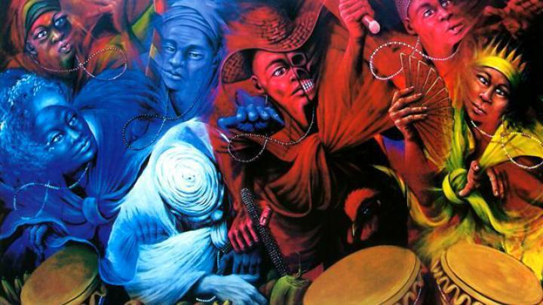
THE POWER OF THE ORISHAS

Slide 11
WORKING & HEALING INSIDE THE ORISHA GARDENS
You will receive a Consultation to identify your issues.
Then a Divination will be performed to identify the underlying issue.
You will then be working outside with the Orishas with shelter, offering prayers and making offerings to help you to connect to the elemental powers.
After this you will receive a Healing session to clear away accumulated heavy energy
THE COST is €130.00
EXTRAS AVAILABLE... HERBAL TEAS & CLEANSING BATHS Cost: €35

Slide 12
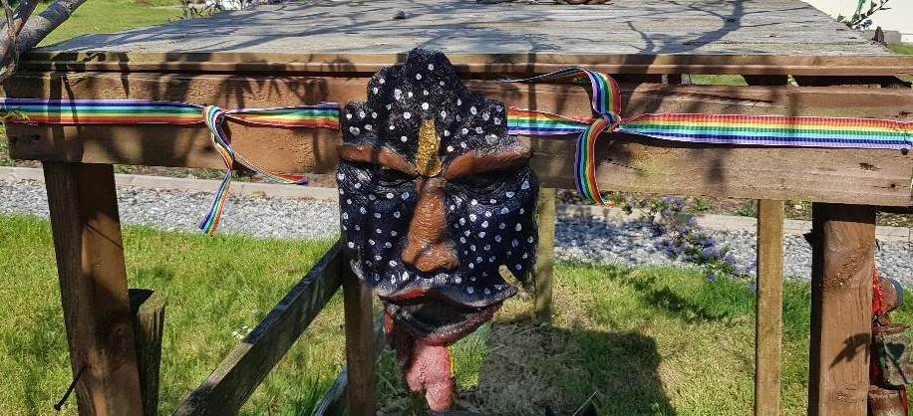
BOOK NOW 0834729056
Email iyanlabivinet@yahoo.com

